Slide 1

Exploratory Data Analysis: The Beauty Industry & The “Luxury Marker”
Group 15: Eliram, Lisa, Judi
Data Analysis with Python and SQL Winter Quarter 2026

Slide 2
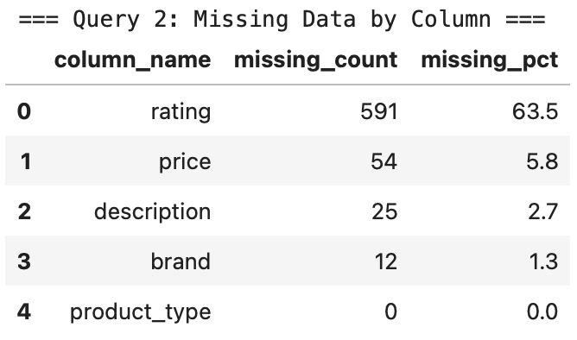
The Beauty Industry Paradox
DO HIGHER PRICES GUARANTEE SUPERIOR QUALITY?
IS PRICE A SIGNAL OF PERFORMANCE OR A BYPRODUCT OF MARKETING?
AUDIENCE: CONSUMERS NAVIGATING MARKETING “FLUFF” AND BRAND MANAGERS SEEKING MARKET POSITIONING
MARKETING FOCUS: PRODUCT COPY LENGTH AND GREEN CLAIMS
MAKEUP API: +900 PRODUCTS FROM +50 BRANDS (AFTER CLEANING)
Notes:
When entering Sephora, a pharmacy, or any place where you can buy cosmetics, it is natural to ask whether higher prices guarantee superior quality.
is the $50 DIOR lipstick really better than the $5 CVS version?
- Introduce audience:
This project is directed at consumers navigating marketing fluff and brand managers seeking market positioning
-So, we investigated whether price premiums reflect actual satisfaction or are simply a byproduct of aggressive marketing.
For this,
- We used makeup API to analyzed 931 products from 50+ brands.
As an integrity Check, we accounted for the fact that while 63% lack ratings, price data is 95% complete, which allows us to analyze price

Slide 3

Our Hypotheses
PRODUCTS MARKETED WITH “GREEN” OR SUSTAINABILITY RELATED TERMS WILL RECEIVE HIGHER RATINGS AND POTENTIALLY COMMAND HIGHER PRICES DUE TO INCREASING CONSUMER DEMAND FOR SUSTAINABLE COSMETICS
PRICE–QUALITY GAP
DESCRIPTION PREMIUM
ARE GREEN CLAIMS A STANDARD OR LUXURY?
Notes:
We believe that green/sustainability related terms will receive higher ratings and potentially have higher prices, due to increasing demand of sustainable cosmetics
The higher the price the higher the quality
A more elaborate description would characterize luxurious products
Are green claims a marker of luxury?

Slide 4
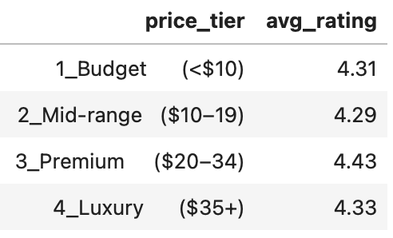
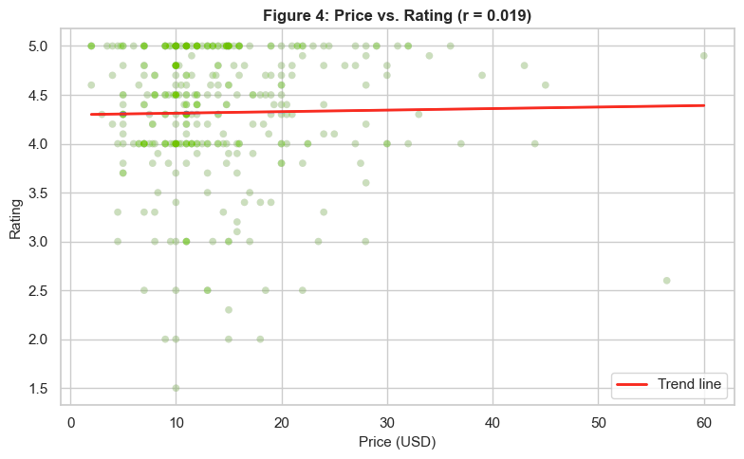
Finding I: The Price-Quality Myth
Our expectation: Luxury or “better” products would have significantly higher ratings.
Reality: Consistent ratings across different tiers. Weakly correlated
Notes:
Look at the median rating line, it overlaps for all price tiers!
Whether a consumer spends $10 or $60, their satisfaction remains statistically identical.
This proves that high-quality formulas are fully accessible at budget price points.
*Note: On our correlation findings,

Slide 5
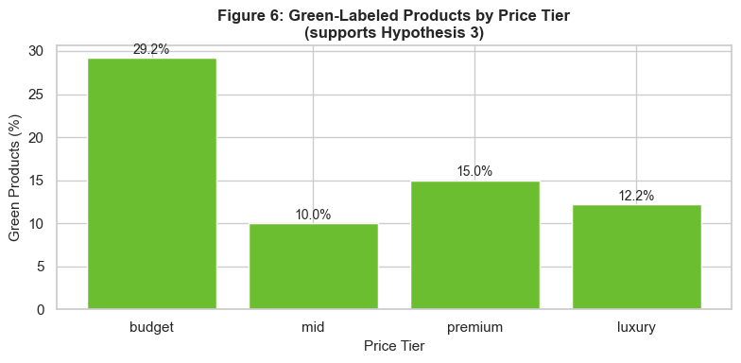
Finding II: The Popularization of Green Beauty
INCONSISTENT PREMIUM
THE PRICE-DROP PHENOMENON
MARKET MATURITY
Notes:
Inconsistent Premium: Not a universal price premium on green products.
Price-drop: in several key categories, "green" products are actually more affordable on average than traditional ones
The lack of a consistent premium indicates that "Clean Beauty" is no longer a luxury differentiator, but a mass-market reality.
One the following SLIDE ->

Slide 6
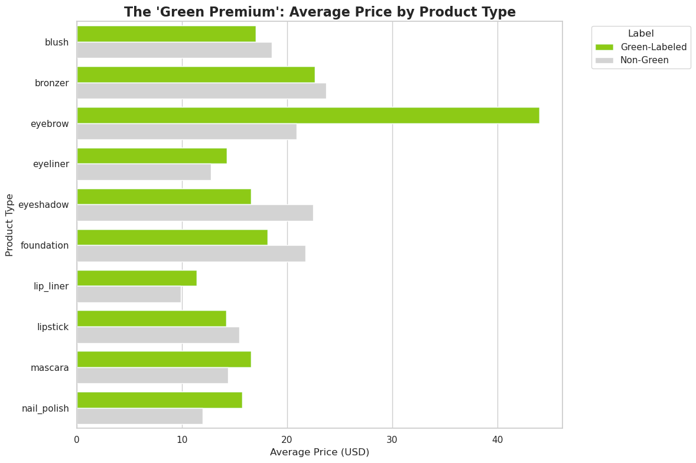
Notes:
We also observe that, for different product types, there is not a clear Green Premium. In fact, in many cases, Green products retail for cheaper (on average)
We found this to be additional evidence that green products are not rewarded any more than traditional products.
So, the green-product premium is a myth

Slide 7
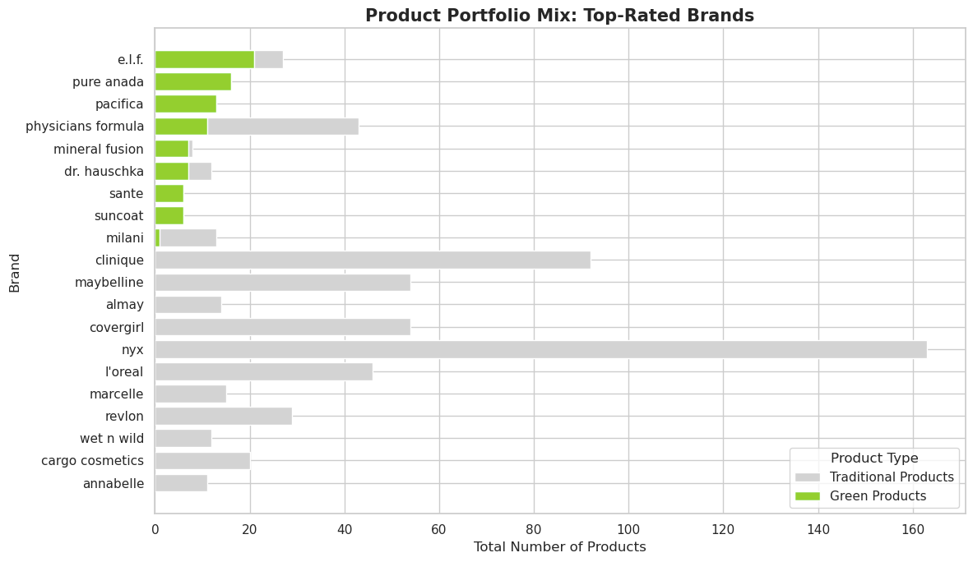
Insight: Green Product Brand Portfolios
100% Green Portfolios are fully viable
Brand Equity and Specialized Positioning
Notes:
An additional insight from our Green Marketing exploration is the specific brands' portfolio of green products:
We observe that there are brands that have 100% green-branded products and they are fully viable.
So, this leads us to wonder if it is brand positioning and specialization that allow the brands with no green claims to stay in the market so comfortably.

Slide 8
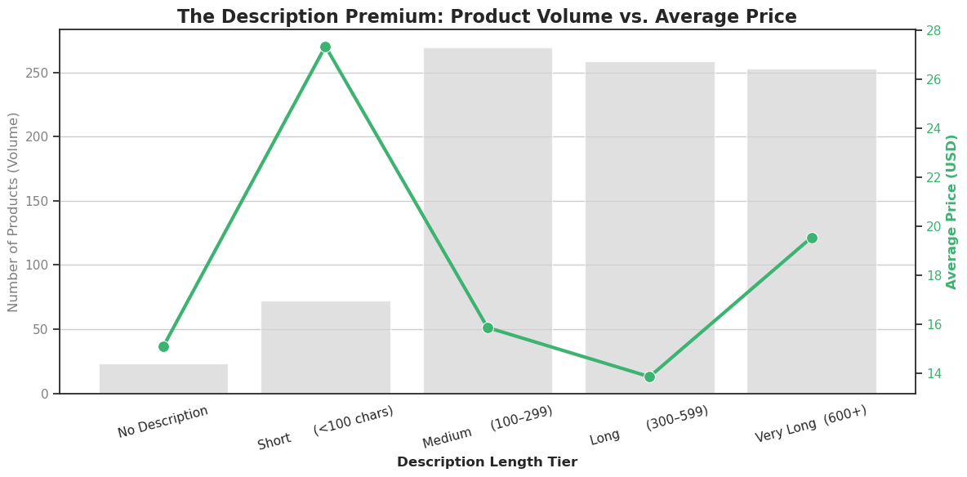
Finding III: The Description Premium
Luxury Relies on Brand Confidence
Short Descriptions Paradox
The Mid-Market “Romance”
Mid-Market relies on Copy Complexity
Notes:
In addition to green marketing, we expected longer, elaborate descriptions to justify higher prices.
Instead, we found a paradox: true luxury brands often use the least amount of marketing copy.
As seen on the graph, those descriptions with less than 100 characters have the highest average prices.
So, luxury brands likely rely on brand prestige, leaving the 'romancing' (lengthy descriptions) to mid-market brands trying to justify their costs. (Which we tested in our price-predicting model)
Again, Luxury relies on Brand Confidence, so it seems that it is the mid market has to justify their product through verbose descriptions.

Slide 9
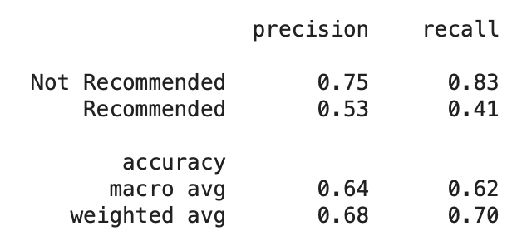
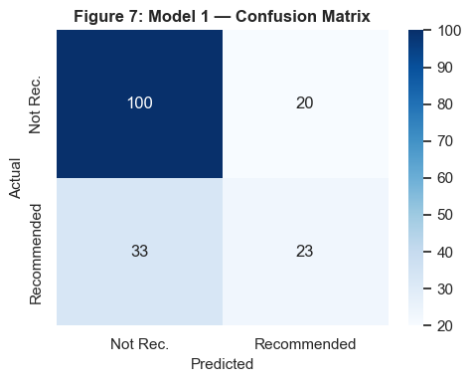
Model I: Recommended Products
PRICE-QUALITY MYTH EVIDENCE:
WEIGHTED AVG: PRECISION (0.68) VS RECALL (0.70). A 2% Difference!
MODEL IDENTIFIES ‘LOSERS’ BETTER THAN ‘WINNERS’
CAN’T PREDICT CONSUMER SATISFACTION, AS IT IS NON-LINEAR, HIGH-DIMENSIONAL
THIS CONFIRMS THAT PRICE & WORD COUNT ARE WEAK SIGNALS OF WHAT CONSUMERS LIKE.
Notes:
So, with our 1st model, we wanted to put the price-quality myth to the test.
The Model Achieves 0.70 RECALL Weighted ACCURACY, only 2% better than the PRECISION Weighted ACCURACY.
So, price and word count are weak signals of what consumers like, as we can predict only 2% better than taking a random guess.
Then, consumer satisfaction is confirmed to be non-linear and multi-dimensional.
Looking at the confusion matrix,
we observe that the high number of False Negatives (18) demonstrates that our
Our chosen features are weak Predictors of product recommendation.
If quality were truly linked to price, the model would have had far fewer False Negatives.
This mismatch is the statistical proof that the beauty industry is driven by brand loyalty, things that data on marketing simply cannot capture.

Slide 10
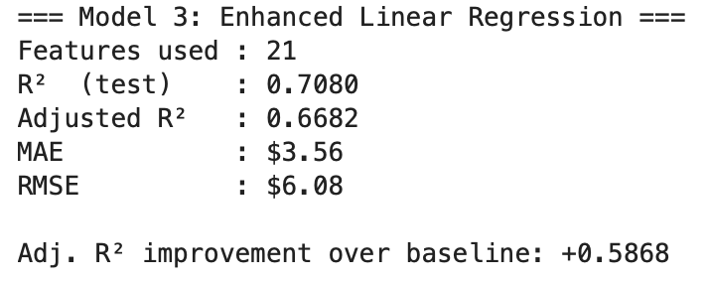
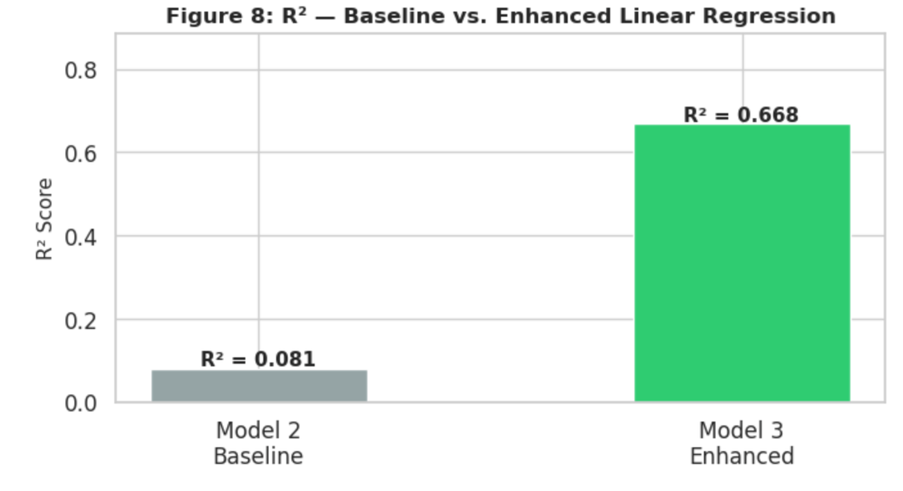
Models II & III: Predicting Price
WHAT ACTUALLY EXPLAINS WHY SOME PRODUCTS ARE MORE EXPENSIVE THAN OTHERS?
OUR INTIAL R2 WAS VERY LOW (USING RATING AND WORD COUNT ), SO WE DECIDED TO ADD BRAND AVERAGE PRICE AND BRAND PRODUCT COUNT AS PREDICTORS.
WE FOUND THAT BRAND POSITIONING IS THE PRIMARY DRIVER OF PRICE, FAR OUTWEIGHING RATING & DESCRIPTION LENGTH
SEVERELY BOOSTED OUR ADJUSTED R2: 66.8% VARIANCE EXPLAINED
Notes:
On model 2 we prioritized rating, description length, and product type as predictors of price. This resulted in a low adjusted R2, telling us that product quality is a terrible predictor of price.
However, after adding Brand context to our model, we can predict the retail price within a $3.56 Error (MAE) or $6.08 RMSE.
So, we confirm our finding that brand positioning is more impactful than ratings, or description length.
Q&A: The error decreased on the model, so this tells us the predictive power is not a result of overfitting.

Slide 11

Recap: Marketing Strategy Insights
OUR MODELS CONFIRMED OUR FINDINGS!
LUXURY BRANDS RELY ON BRAND PRESTIGE, NOT VERBOSE COPY
IT IS ALL ABOUT EXISTING BRAND EQUITY
CLEAN BEAUTY IS A BASELINE REQUIREMENT FOR NEW COMPANIES & MARKET ENTRY
TOP-RATED BRANDS ARE MID-SIZED, CONSUMER REWARD PRODUCT SPECIALIZATION NOT GENERALISTS
Notes:
Clean beauty is not a differentiator for high-end pricing, but a baseline requirement
Luxury-aiming Brands should focus on investing in brand positioning, as this does the heavy lifting, allowing the copy to be brief and confident
This branding can be: packaging, exclusivity, and community building.
Our models confirmed our findings by acting as a "lie detector":
1. Price is a marketing construction (confirmed after adding brand avg price, branding count)
2. The logisticc regression confirmed that price is a poor predictor of quality/preference (as with false negatives, consumers loved these products even though the model unfavored them)

Slide 12
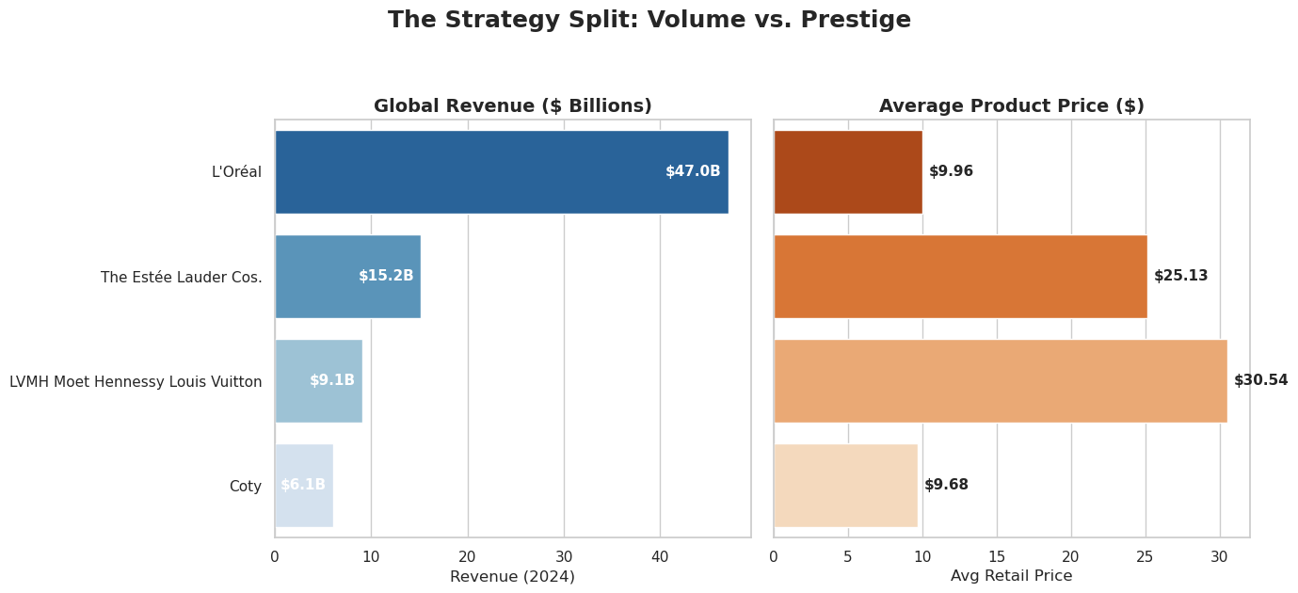
The Success of Budget-Friendly Brands
Notes:
We can also observe this trend in how the largest companies by volume
have the most BUDGET FRIENDLY PRODUCTS!
This shows us that the price-quality link is a MARKETING CHOICE!
So, high prices are not needed to be the most successful.
A high price tag is a marketing choice to create brand prestige, which we just saw is the main concern for luxury brands.

Slide 13
Next Steps
1. DO "SHORT-DESCRIPTION" HIGH-PRICE ITEMS ALL BELONG TO SPECIFIC LUXURY BRANDS?
2. SENTIMENT ANALYSIS TO LOOK FOR WHAT GREEN PRODUCTS GET MORE "EMOTIONAL/POSITIVE" REVIEWS, NOT JUST RATINGS.
3. REGRESSION MODEL: GIVEN THE COMPLEX NATURE OF RATINGS IN THE COSMETIC INDUSTRY, ADDITIONAL FEATURES (SUCH AS INGREDIENTS) AND A MORE COMPLEX MODEL (SUCH AS RANDOM FOREST) COULD BE USED TO TEST OVERLAPPING MARKERS.
Notes:
1. we would find out more about this using a larger, more updated data set, such as the paid Sephora API.
2. Sentiment analysis on actual user reviews could provide us additional insight on customer satisfaction, beyond the ratings, although this might require more extensive data sources, as reviews are even more scarce than ratings.
3. We determined that the variables used to predict ratings in the cosmetic industry were not linear. So, looking at additional features (such as ingredients) and using a more complex model (such as random forest to look at intersectionality) could be used to test overlapping markers.

Slide 14
Thank You!

